Slide 1




Week-3 (Discussion)
8th Aug, 2025
Computer Vision
Prof. Jayanta Mukhopadhyay
Professor
Computer Science and Engineering Department
IIT Kharagpur
Ayan Paul
PMRF Research Scholar
IIT Kharagpur

Slide 2
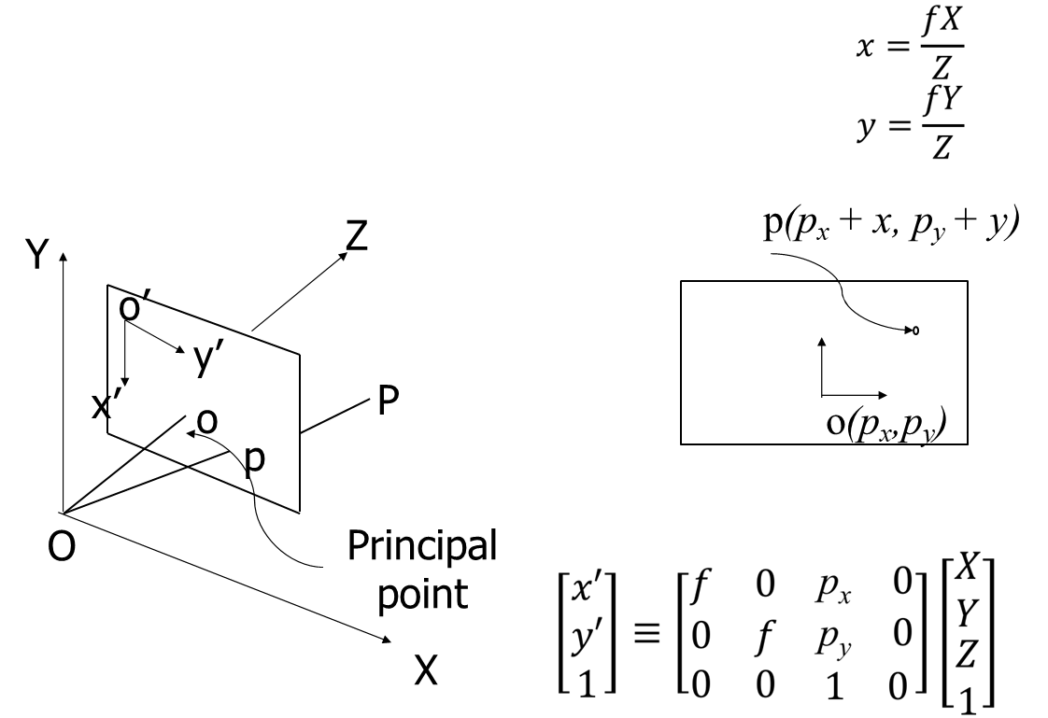
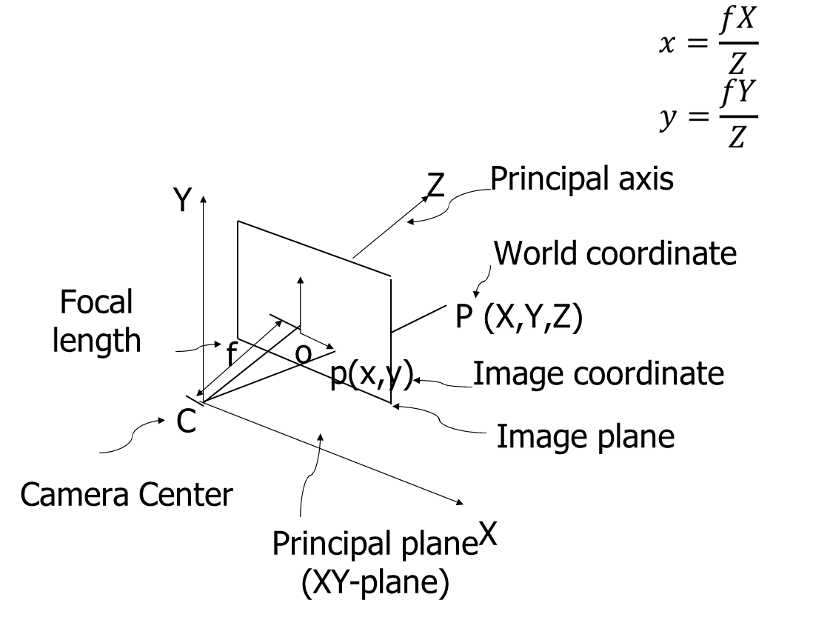
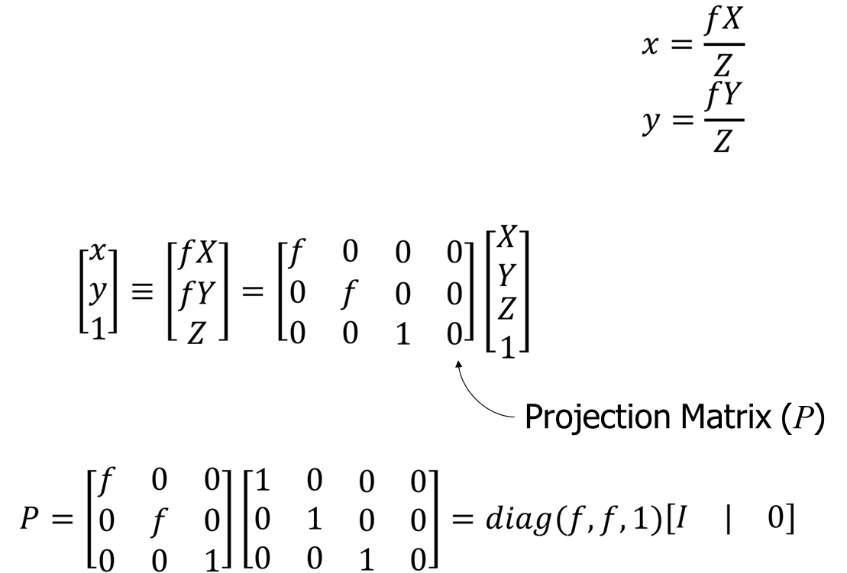
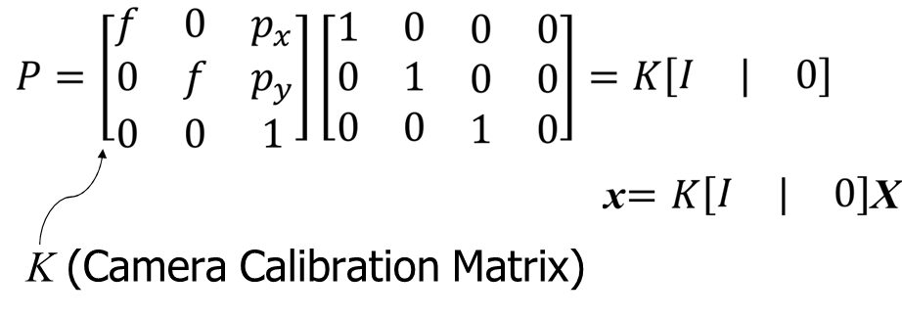
Camera Geometry
Camera geometry in computer vision defines the mathematical relationship between 3D points in the world and their 2D projections on the image plane through models like pinhole or perspective projection.
Pinhole Camera
The pinhole camera is a simplified camera model used in computer vision to describe how a 3D scene is projected onto a 2D image plane. It assumes:
A single point (the pinhole or camera center) through which all light rays pass.
A flat image plane where the rays intersect, forming the image.
No lens distortion, aperture, or focus effects.
Offset of principal point
Pinhole Camera Mapping

Slide 3
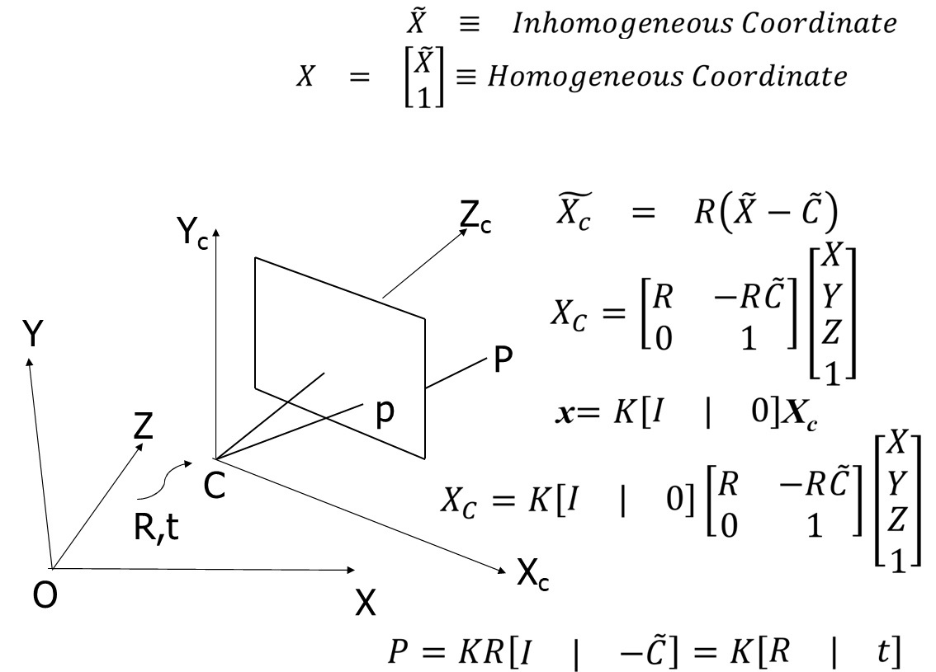
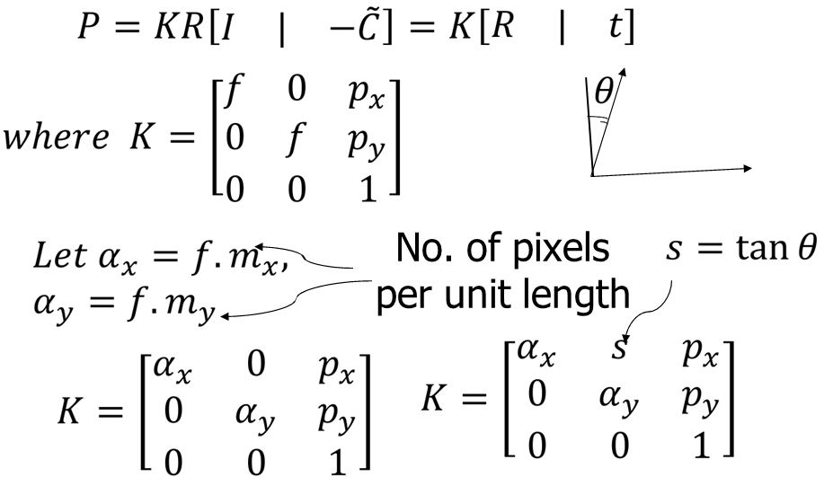
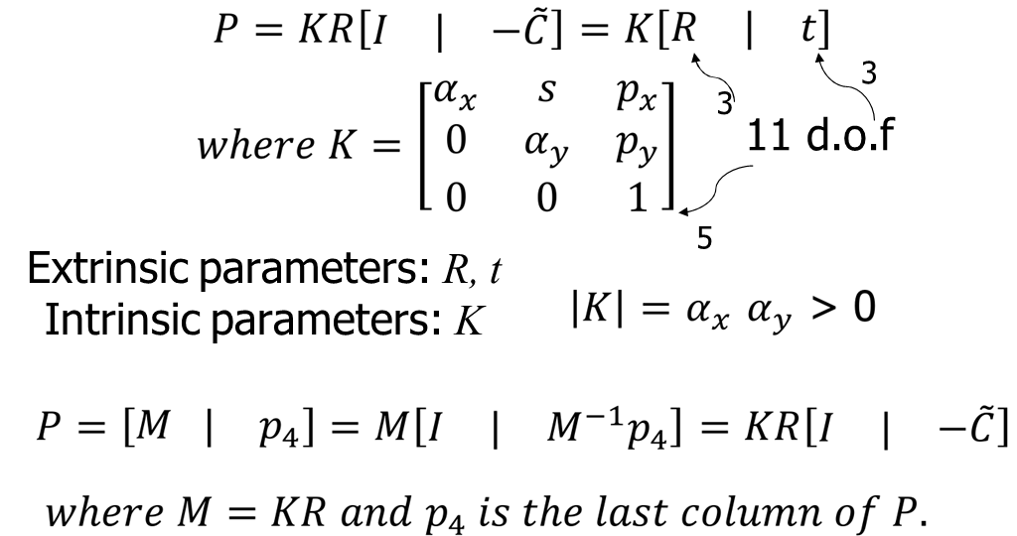
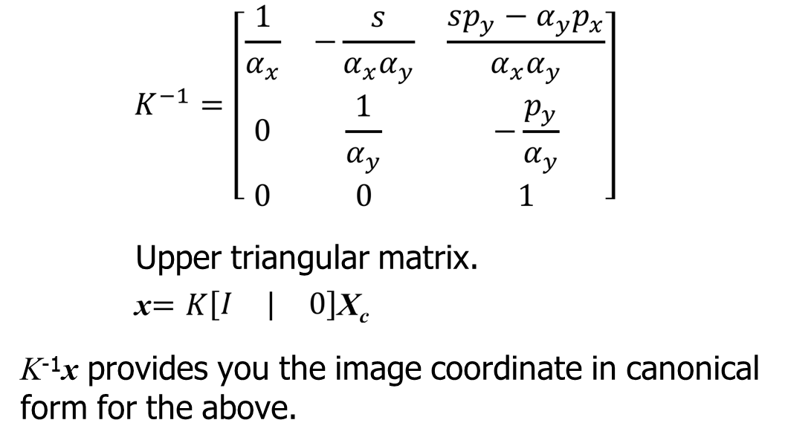
Shifting of World Coordinate
CCD Camera model
The CCD camera model refers to how a Charge-Coupled Device (CCD) sensor captures images, and how this physical process is mathematically modeled in computer vision to relate 3D world points to 2D image coordinates.

Slide 4
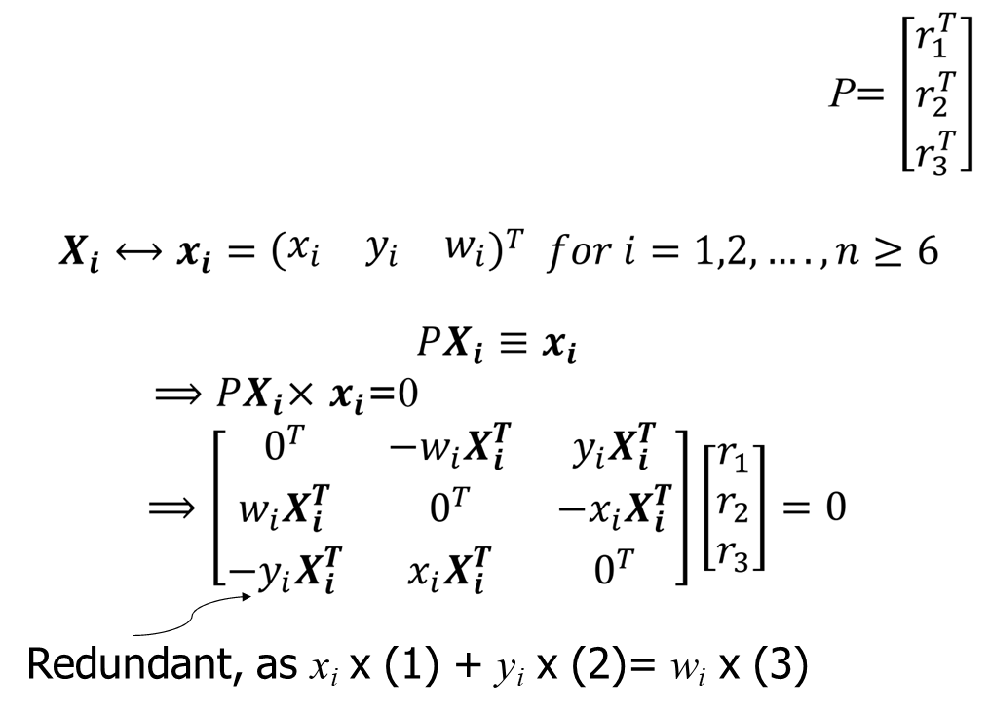
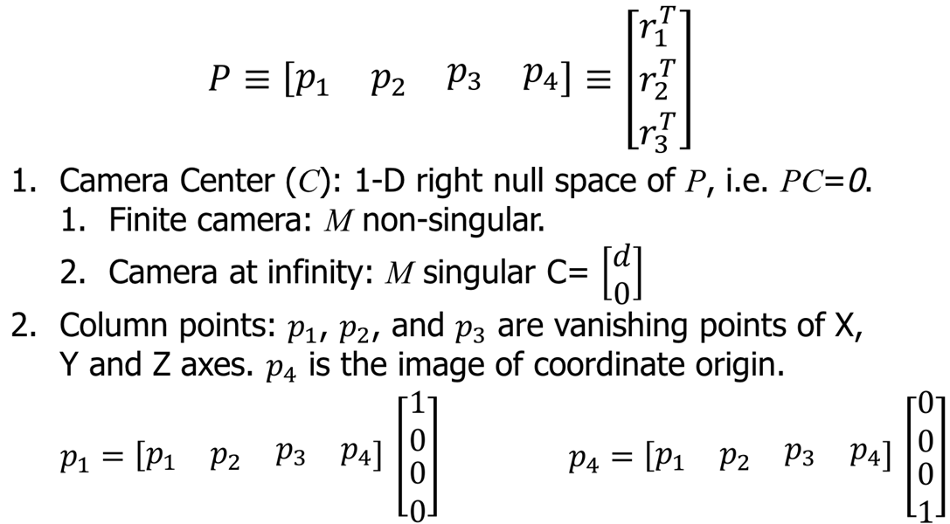
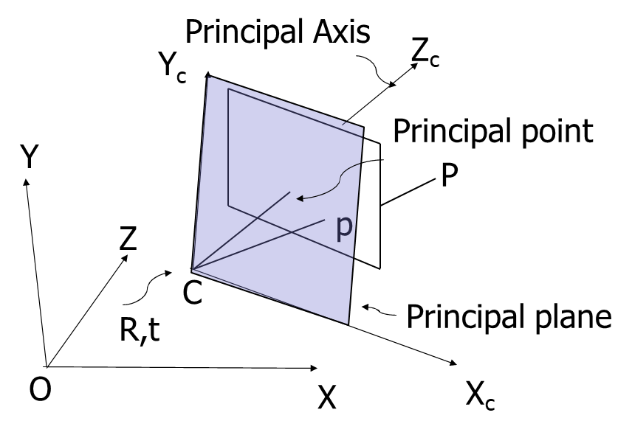
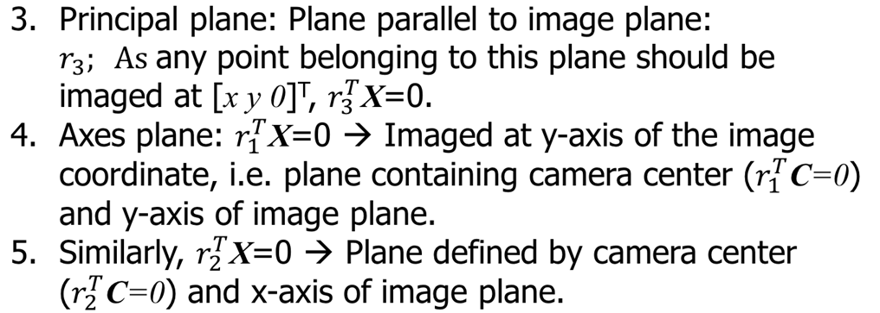
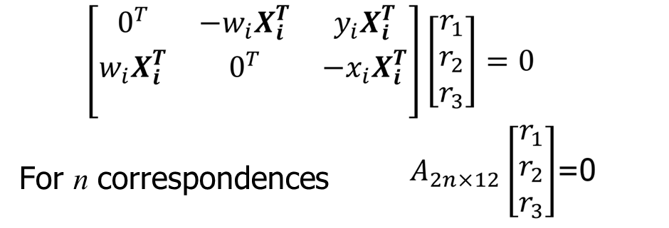
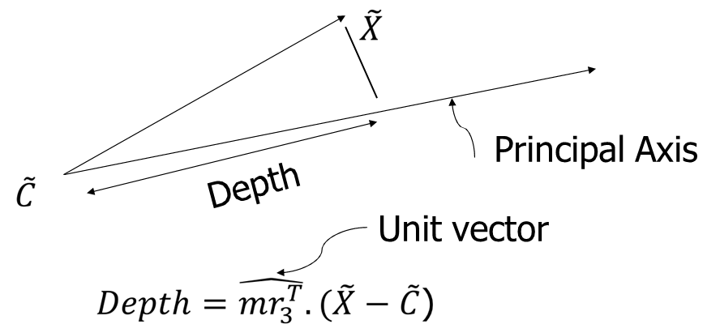
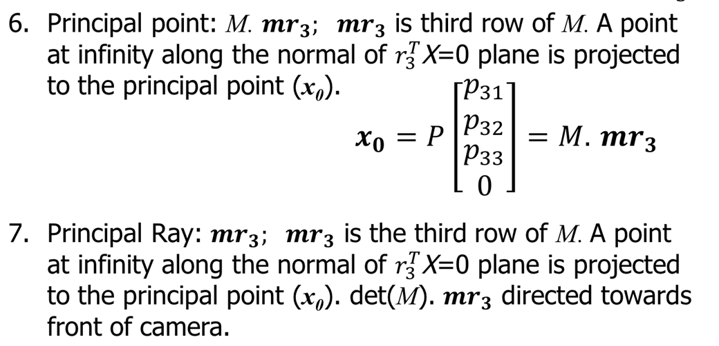
Estimation of the Projective Camera matrix (P)
Properties of projective camera matrix P=[M | p4]
Depth of points

Slide 5
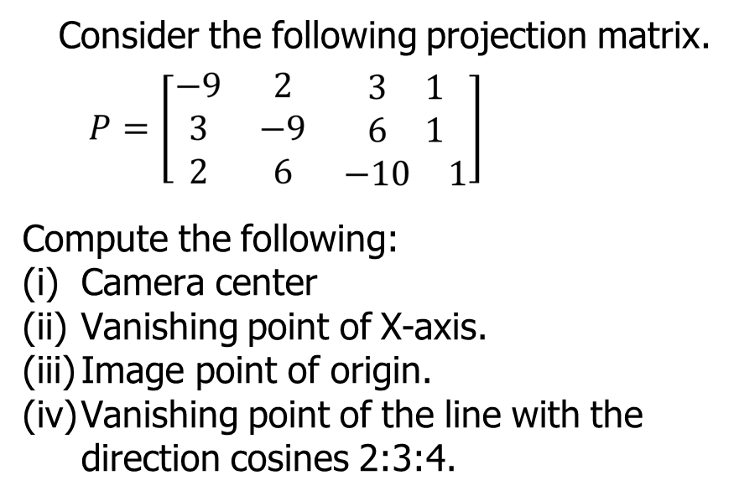
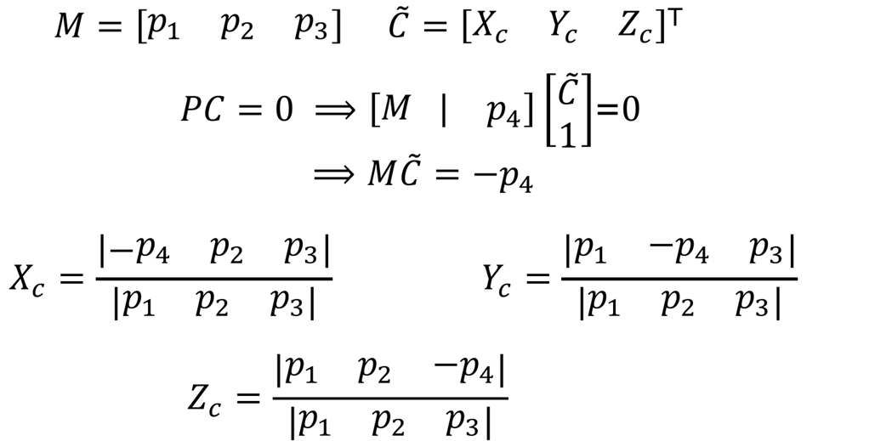
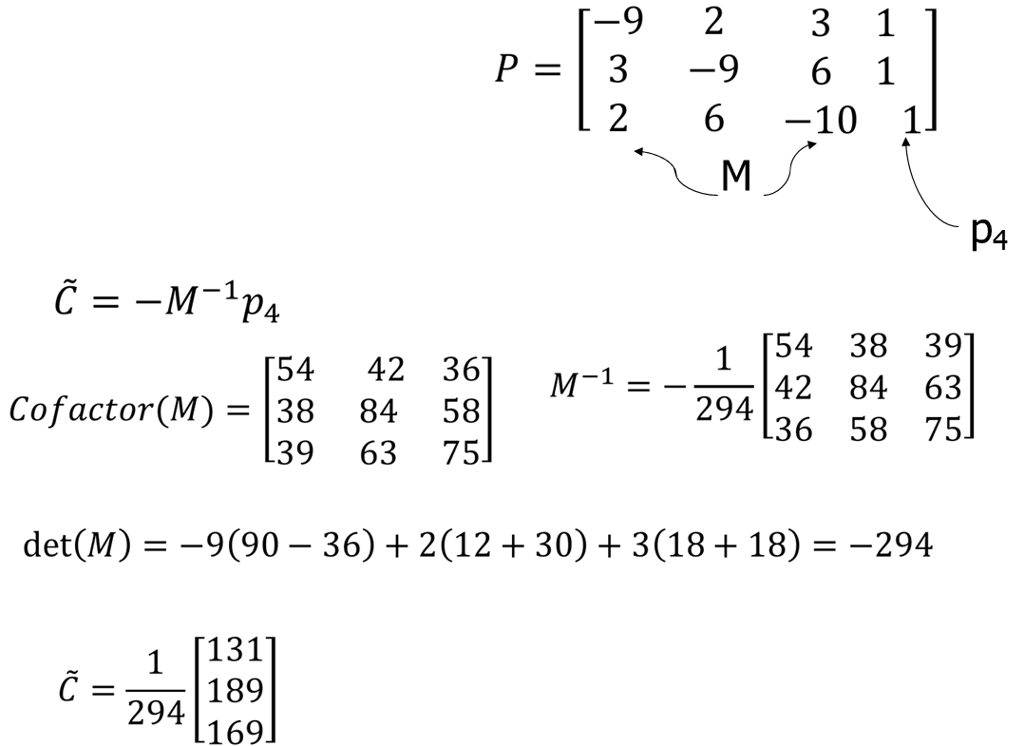
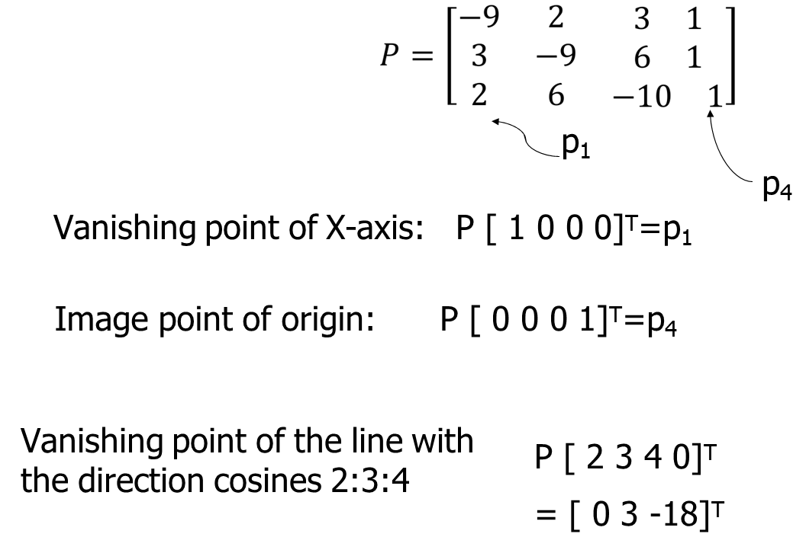
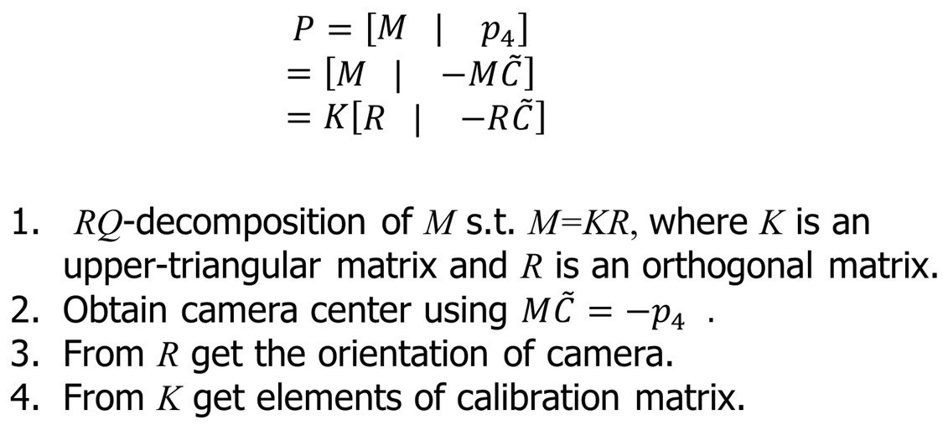
Computing camera center for
P=[M | p4]
Exercise -1
Solution
Camera parameters from P

Slide 6
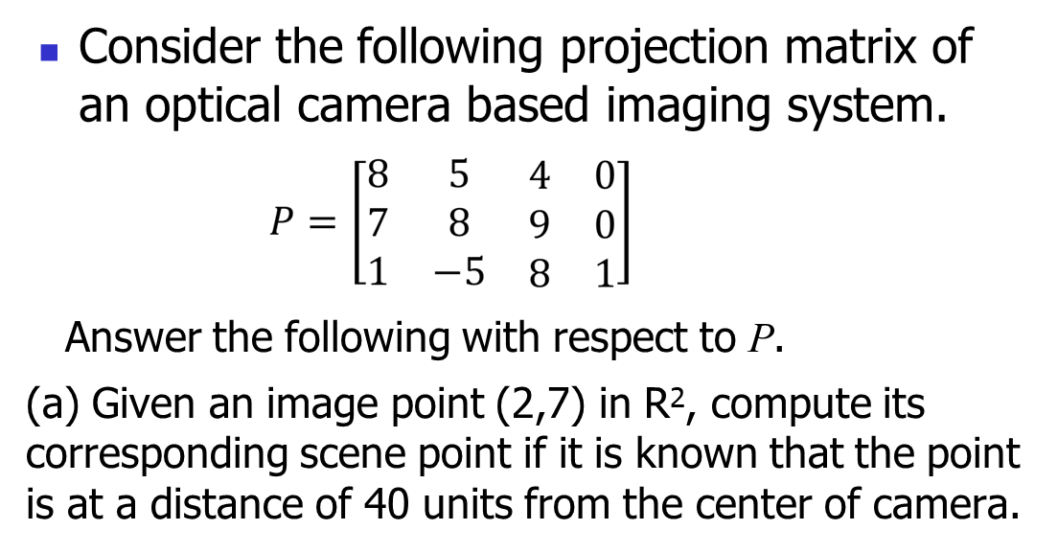
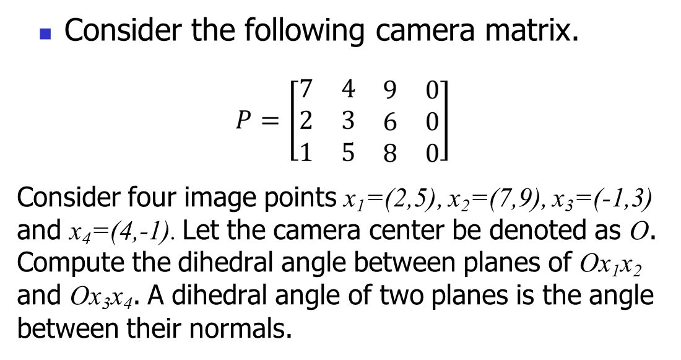
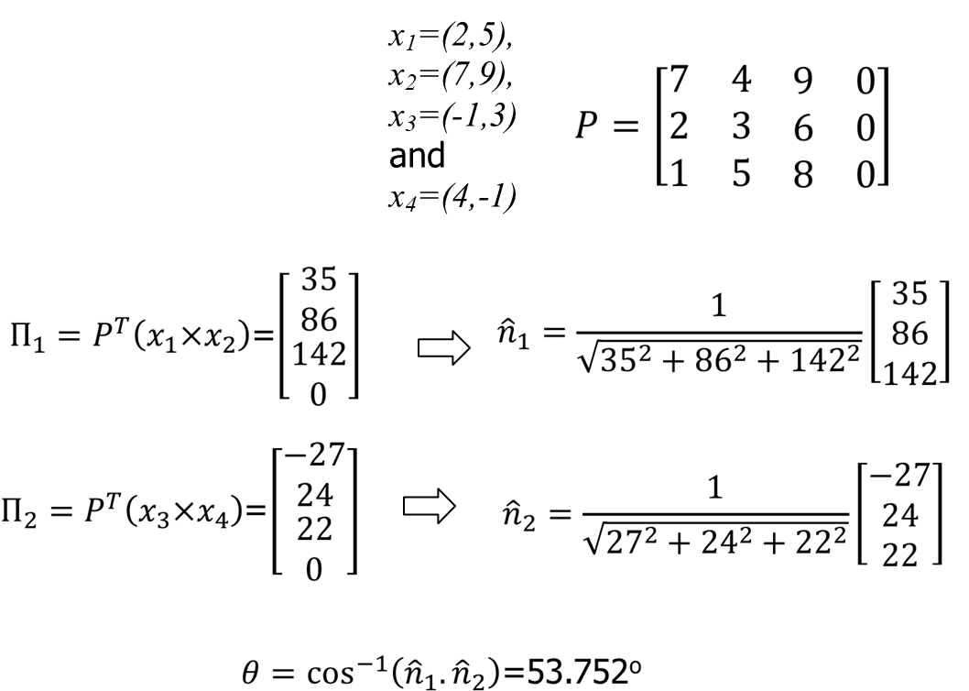
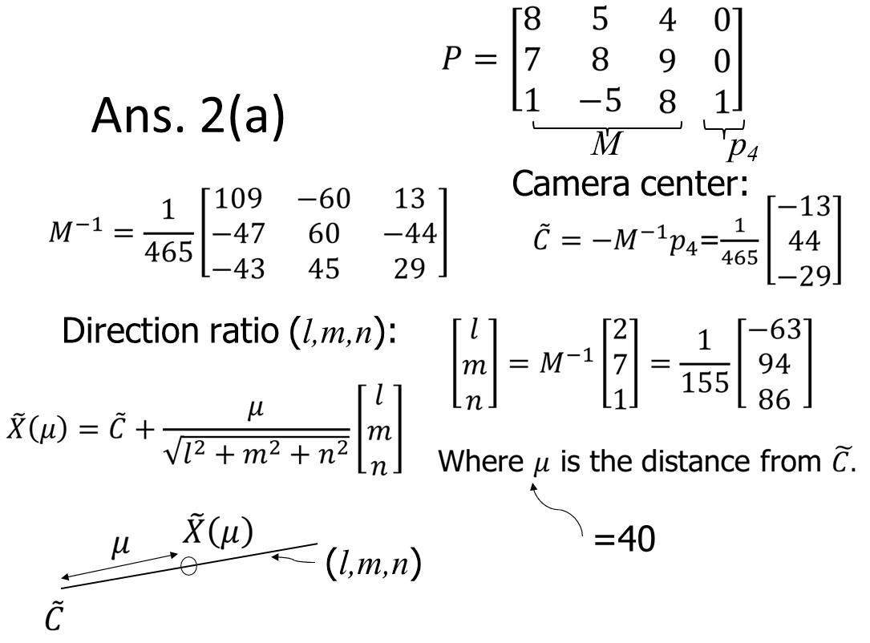
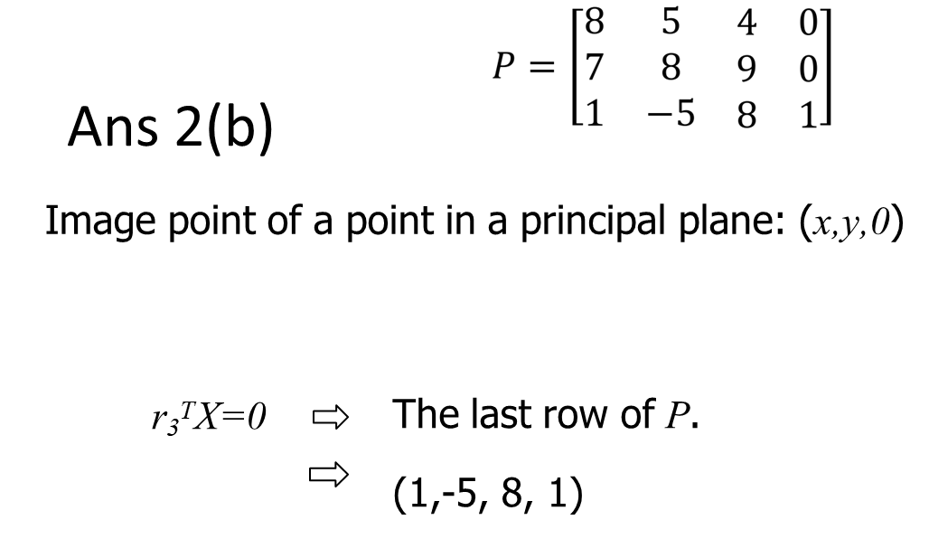
Exercise -2
Exercise -3
(b) Compute the principal plane of the imaging system.
Solution
Solution

Slide 7
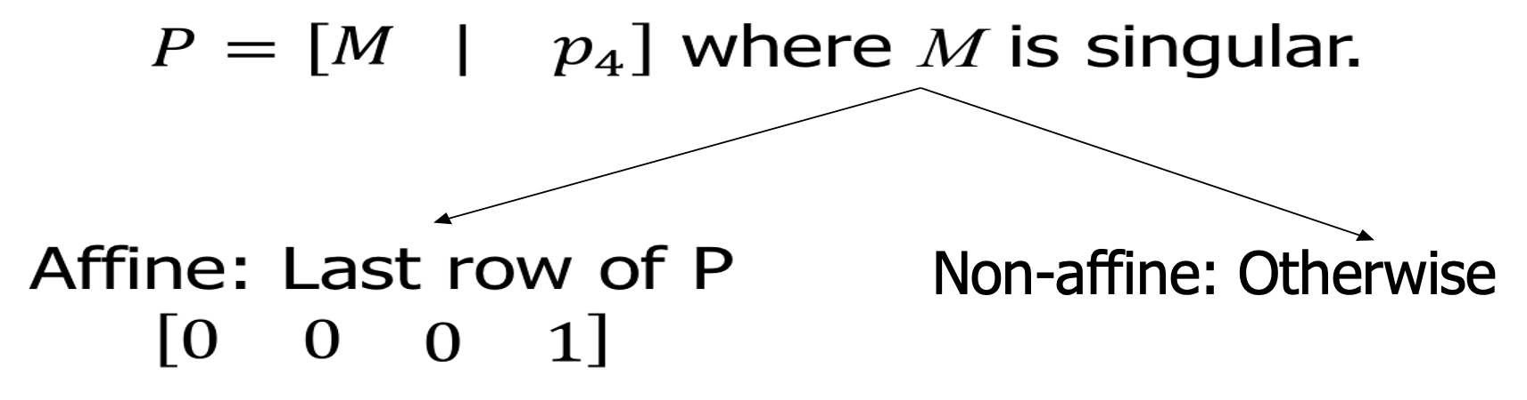
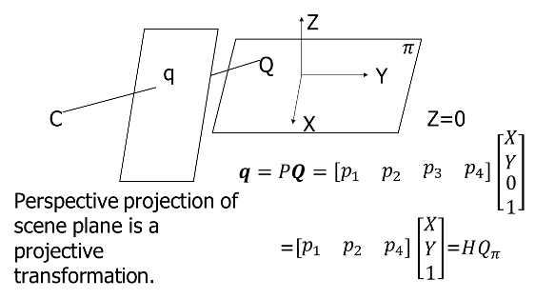
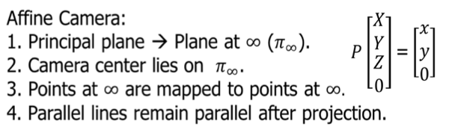
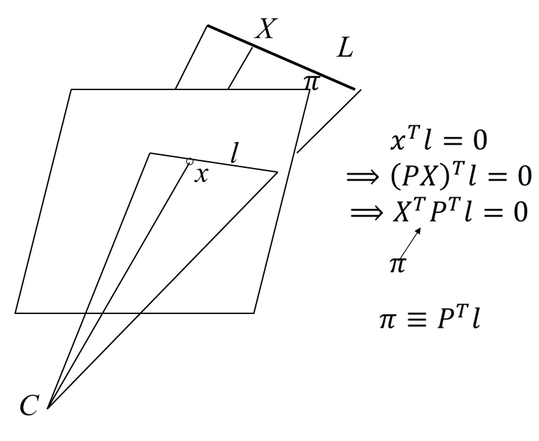
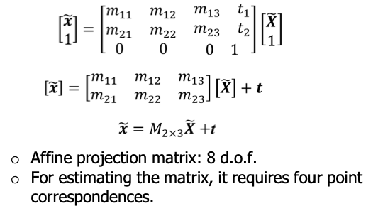
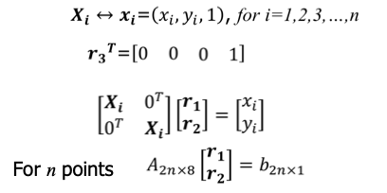

Camera at Infinity (∞)
Projective Camera on plane
Projective camera on a line
Affine Projections

Slide 8
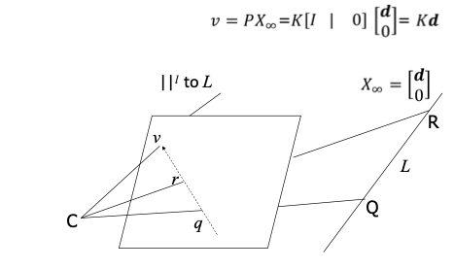
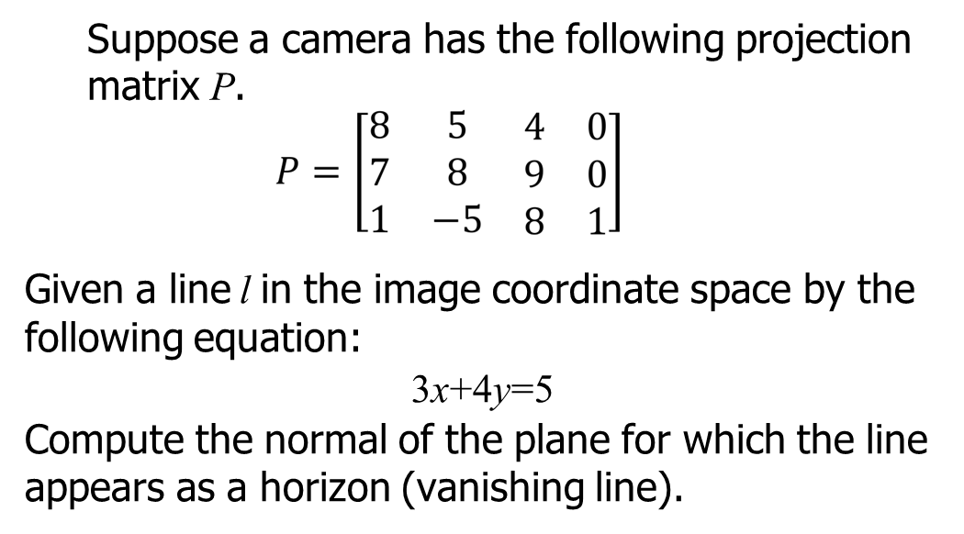
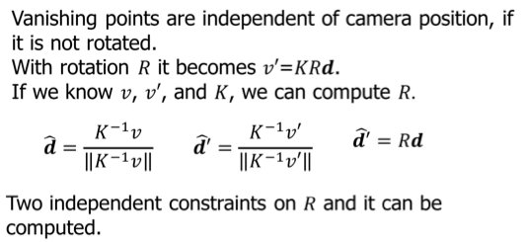
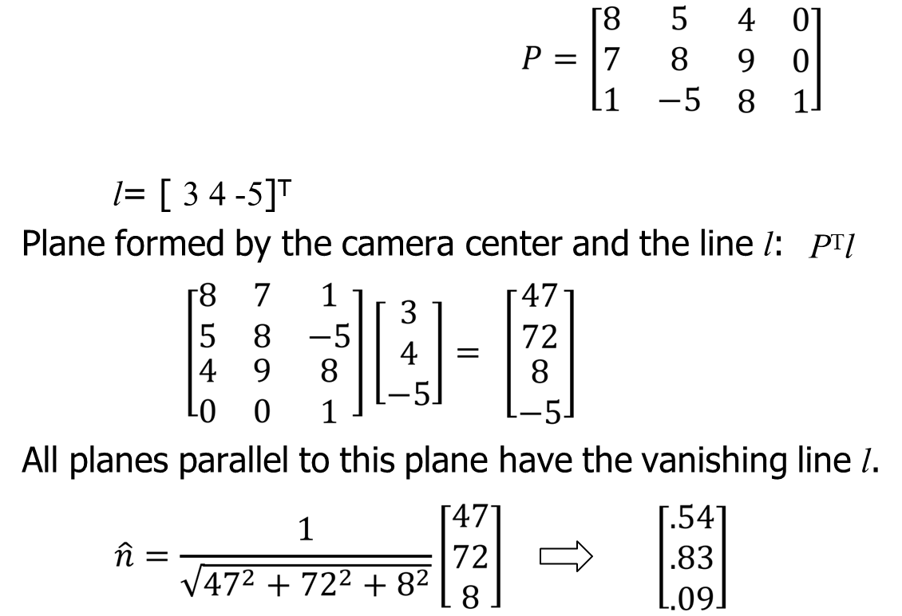
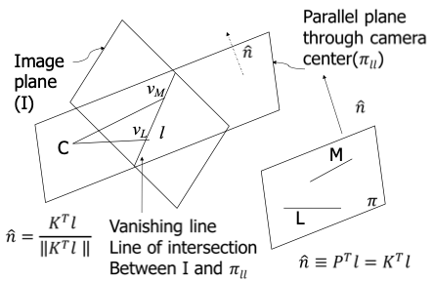
Vanishing Points
Exercise
Solution
Vanishing Lines

Slide 9
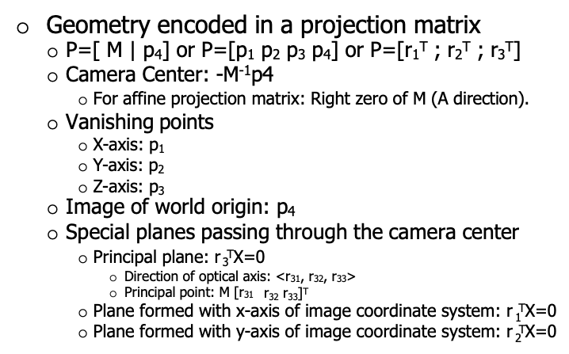
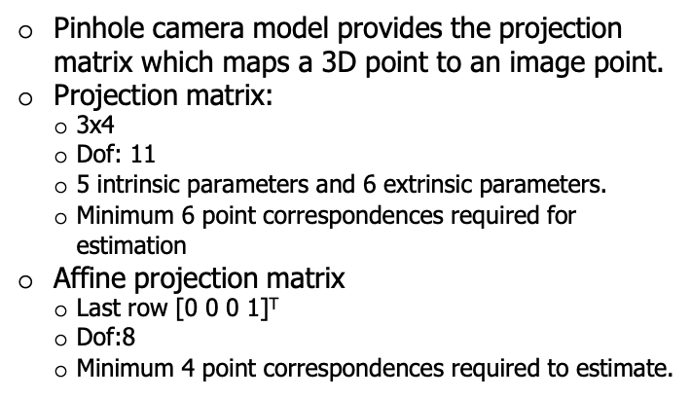
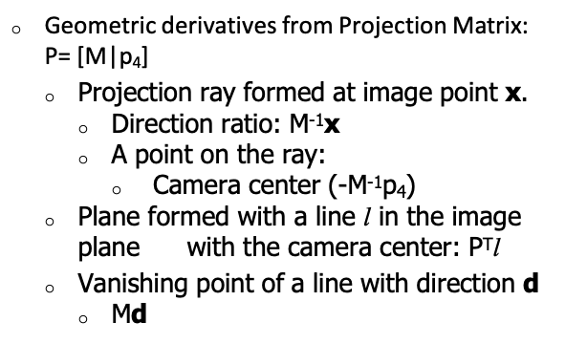
Summary

Slide 10
Topics on which Week 3 Assignment Questions are based
Camera Geometry
Pinhole Camera Mapping, Offsetting Principal Point, Shifting World Coordinate
CCD Camera Model
Projective Camera Matrix and its Properties
Camera Parameters from Projective Camera Matrix
Projective Camera on Plane and Line
Camera at Infinity, Affine Projections, Vanishing Points and Vanishing Line

Slide 11
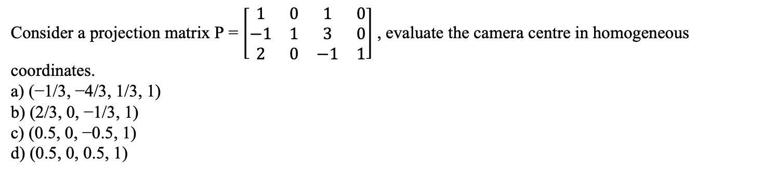
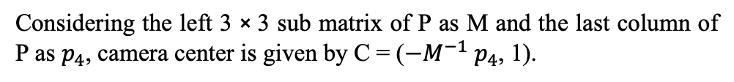
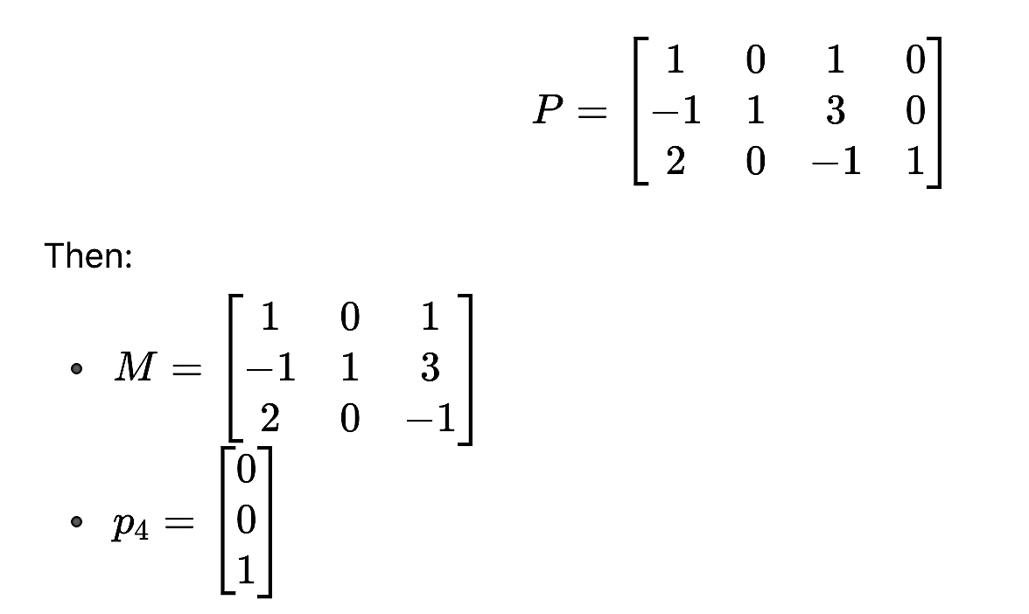
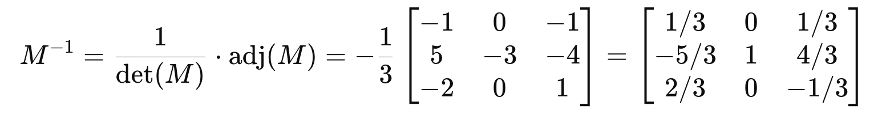
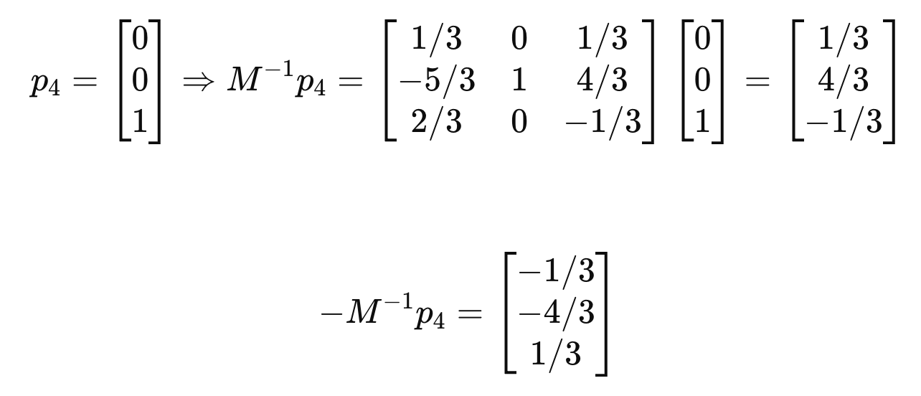
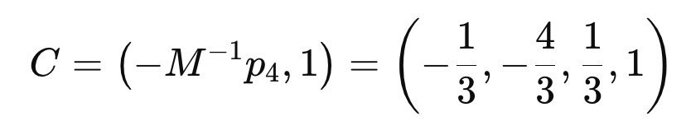
QUESTION 1
SOLUTION 1
CORRECT ANSWER 1
a)

Slide 12
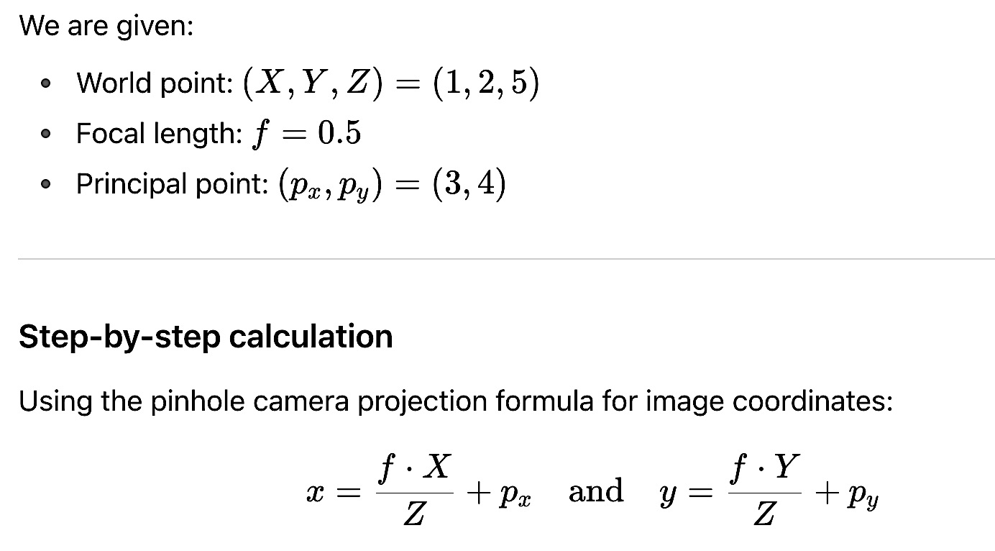
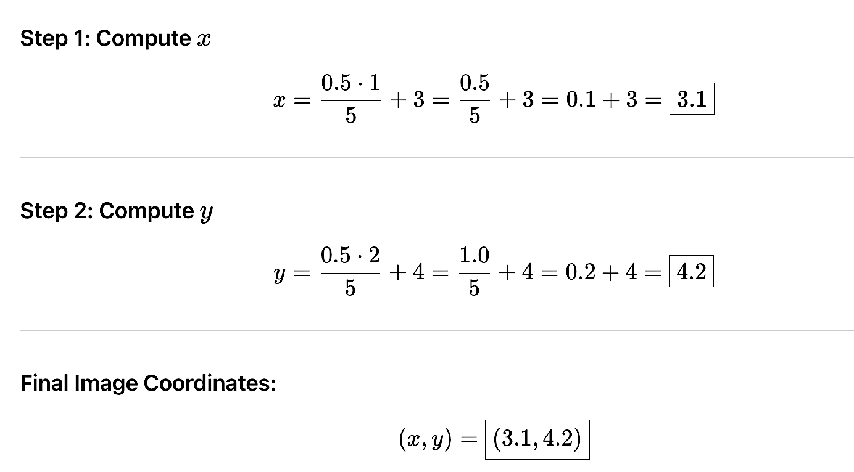
QUESTION 2
If the principal point is located at (3, 4) in the coordinate system of the image plane, what would be the image coordinates of the world point (1, 2, 5), using a pin hole camera with focal length f = 0.5?
a) (2.3, 4.4)
b) (3.3, 3.4)
c) (3.1, 4.2)
d) (2.3, 3.4)
SOLUTION 2
CORRECT ANSWER 2
c)

Slide 13
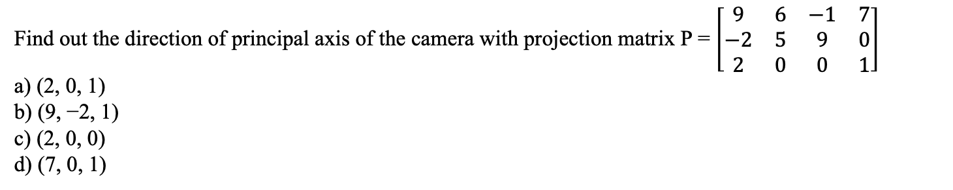


QUESTION 3
SOLUTION 3
CORRECT ANSWER 3
c)

Slide 14

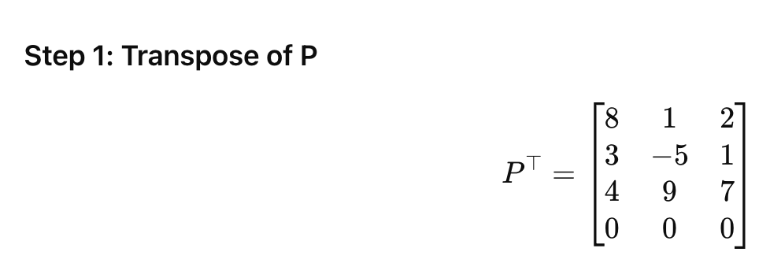
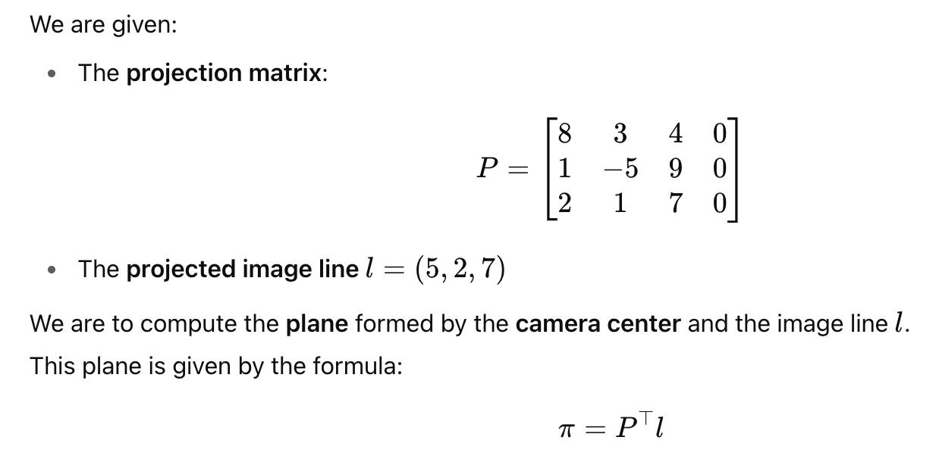

QUESTION 4
SOLUTION 4
CORRECT ANSWER 4
b)

Slide 15



QUESTION 5
SOLUTION 5
CORRECT ANSWER 5
a)

Slide 16








QUESTION 6
SOLUTION 6
CORRECT ANSWER 6
c)

Slide 17

QUESTION 7
Note: Perspective projective mapping is imaging the 3D world coordinates to an image plane using a projective camera where all the rays pass through a camera center. Consider the camera center is at (0, 0, 0) and the image plane is parallel to XY plane and at a distance of f from it. The Perspective projective mapping from world coordinates (1, 4, 5) to image coordinates, using a camera with focal length f = 0.25, is
a) (1/6, 1/3)
b) (1/20, 1/5)
c) (1/3, 1/6)
d) (1/6, 1/2)
SOLUTION 7
CORRECT ANSWER 7
b)

Slide 18





QUESTION 8
SOLUTION 8
CORRECT ANSWER 8
a)

Slide 19





QUESTION 9
SOLUTION 9
CORRECT ANSWER 9
d)

Slide 20





QUESTION 10
SOLUTION 10
CORRECT ANSWER 10
a)

